Slide 1
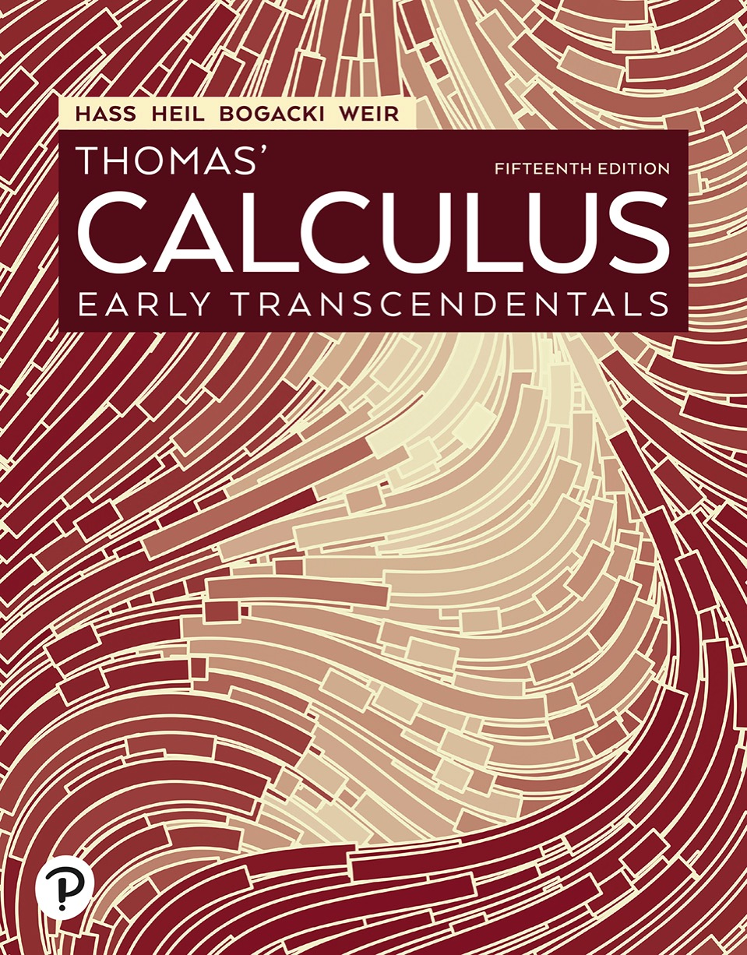

Thomas’ Calculus: Early Transcendentals
Fifteenth Edition
Chapter 16
Integrals and Vector Fields
Copyright © 2023, 2018, 2014 Pearson Education, Inc. All Rights Reserved
Notes:
If this PowerPoint presentation contains mathematical equations, you may need to check that your computer has the following installed:
1) MathType Plugin
2) Math Player (free versions available)
3) NVDA Reader (free versions available)

Slide 2
Section 16.5 Surfaces and Area

Slide 3
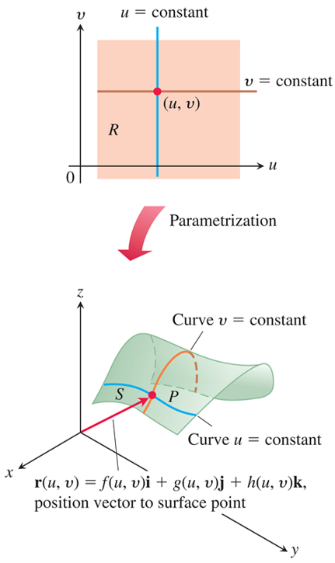
Parametrizations of Surfaces (1 of 6)
A parametrized surface S expressed as a vector function of two variables defined on a region R.
Notes:
The first graph plots a rectangular region R distributed between the first and fourth quadrants. In the region, a horizontal line, v = constant, and a vertical line, u = constant, intersect at a point (u, v) in the first quadrant. After parametrization, the region R in the first graph becomes an irregular shape. The horizontal line, v = constant, and the vertical line, u = constant, become curves. The region to the right of curve v = constant and above curve u = constant is labeled, P. The region to the left of the curve v = constant and below curve u = constant is labeled, S. A vector from the origin moves in the direction of negative x axis and points to the intersection of curve v = constant and curve u = constant. The vector is labeled, r (u, v) = f (u, v) times i + g (u, v) times j + h (u, v) times k.

Slide 4
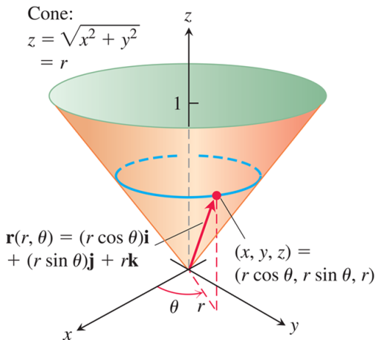
Parametrizations of Surfaces (2 of 6)
The cone can be parametrized using cylindrical coordinates.
Notes:
The height of the cone is 1 unit and the tip of the cone is at the origin. A circle is drawn between z = 0 and z = 1, on the cone. The circle passes through (x, y, z) = (r cosine of theta, r sine of theta, r). A vector, r (r, theta) = left parenthesis r cosine of theta right parenthesis i + left parenthesis r sine theta right parenthesis j + r k, starts from the origin and points to (x, y, z) = (r cosine of theta, r sine of theta, r). The point (x, y, z) is at a distance of r meters from the x y plane. A vertical dotted line from (x, y, z) to the x y plane marks this distance. From the lower end of this dotted line, a dotted line runs to the origin. The line makes an angle of theta with the x axis.

Slide 5
Parametrizations of Surfaces (3 of 6)
Example: Find a parametrization of the cone
Solution: Here, cylindrical coordinates provide a parametrization. A typical point (x, y, z) on the cone has
and
with
Taking u = r and
gives the parametrization
The parametrization is one-to-one on the interior of the domain R, though not on the boundary tip of its cone where r = 0.

Slide 6
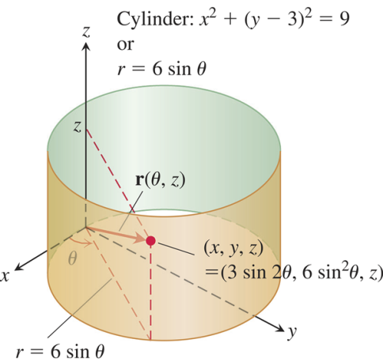
Parametrizations of Surfaces (4 of 6)
The cylinder can be parametrized using cylindrical coordinates.
Notes:
with its center at (x, y, z) or (3 sine of 2 theta, 6 sine squared theta, z). The graph has a rectangular plane that makes an angle theta with the x axis and has length, r = 6 sine of theta, width, z, and diagonal, r of start expression theta comma z end expression."

Slide 7
Parametrizations of Surfaces (5 of 6)
Example: Find a parametrization of the cylinder
Solution: In cylindrical coordinates, a point (x, y, z)
has
For points on the
cylinder
the equation is the same as
the polar equation for the cylinder’s base in the
x y-plane:

Slide 8
Parametrizations of Surfaces (6 of 6)
Solution (concluded):
or
A typical point on the cylinder therefore has
Taking
gives the one-to-one
parametrization

Slide 9
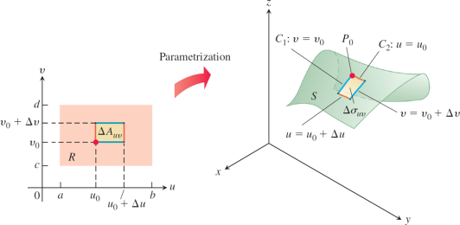
Surface Area (1 of 8)
A rectangular area element
in the
maps onto a curved patch element
on S.
Notes:
The rectangular element delta a, sub start expression u v end expression is parametrized inside a rectangular region R in u v plane. The outer rectangle extends from a to b on the u axis and c to d on the v axis. The inner rectangle extends from u sub 0 to u sub 0 + delta u, on the u axis, and from v sub 0 to v sub 0 + delta v, on the v axis. The second graph plots a shaded curved rectangular region delta sigma sub start expression u v end expression inside a parametrized surface S. The left side of the rectangle is labeled, C sub 1, v = v sub 0. The top side of the rectangle is labeled, C sub 2, u = u sub 0. The right side of the rectangle is labeled, v = v sub 0 + delta v. The bottom side of the rectangle is labeled, u = u sub 0 + delta u. The top left vertex is labeled, P sub 0.

Slide 10
Surface Area (2 of 8)
Definition:
A parametrized surface
is smooth if
are continuous and
is never zero on the interior of the parameter domain.

Slide 11
Surface Area (3 of 8)
Definition: The area of the smooth surface
is

Slide 12
Surface Area (4 of 8)
Surface Area Differential for a Parametrized Surface

Slide 13
Surface Area (5 of 8)
Example: Find the surface area of the cone.
Solution: In a previous Example, we found the parametrization
We first find

Slide 14
Surface Area (6 of 8)
Solution (concluded):
Thus,
The
area of the cone is

Slide 15
Surface Area (7 of 8)
Example: Find the surface area of a sphere of radius a.
Solution: We use the parametrization:
For
we get

Slide 16
Surface Area (8 of 8)
Solution (concluded):
Thus,
Since
Therefore, the area of the
sphere is

Slide 17
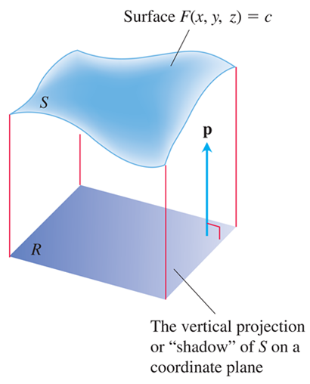
Implicit Surfaces (1 of 7)
As we soon see, the area of a surface S in space can be calculated by evaluating a related double integral over the vertical projection or “shadow” of S on a coordinate plane. The unit vector p is normal to the plane.

Slide 18
Implicit Surfaces (2 of 7)
Formula for the Surface Area of an Implicit Surface
The area of the surface
over a
closed and bounded plane region R is
where p = i, j, or k is normal to R and

Slide 19
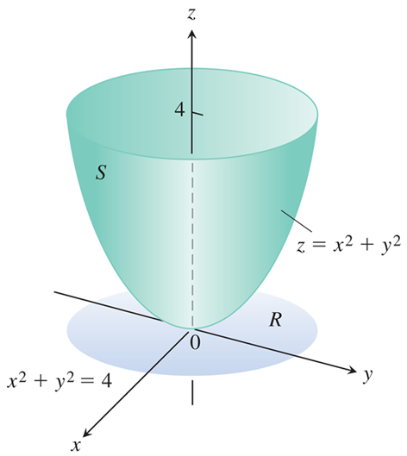
Implicit Surfaces (3 of 7)
The area of this parabolic surface is calculated in the following Example.
Notes:
The projection of circular region R, for x squared + y squared = 4 in the x y plane.

Slide 20
Implicit Surfaces (4 of 7)
Example:
Find the area of the surface cut from the bottom of the
paraboloid
by the plane z = 4.
Solution: We sketch the surface S and the region R below it in the x y-plane. The surface S is part of the
level surface
and R is the disk
in the x y-plane. To get a unit vector
normal to the plane of R, we can take p = k.

Slide 21
Implicit Surfaces (5 of 7)
Solution (continued):
At any point (x, y, z) on the surface, we have

Slide 22
Implicit Surfaces (6 of 7)
Solution (concluded):
In the region R, d A = d x d y. Therefore,

Slide 23
Implicit Surfaces (7 of 7)
Formula for the Surface Area of a Graph
For a graph
over a region R in the
x y-plane, the surface area formula is

Slide 24

Copyright
This work is protected by United States copyright laws and is provided solely for the use of instructors in teaching their courses and assessing student learning. Dissemination or sale of any part of this work (including on the World Wide Web) will destroy the integrity of the work and is not permitted. The work and materials from it should never be made available to students except by instructors using the accompanying text in their classes. All recipients of this work are expected to abide by these restrictions and to honor the intended pedagogical purposes and the needs of other instructors who rely on these materials.

